Slide 1
UPPER SIXTH ARTS
GEOGRAPHY
Lesson 18
Structure of the City in MEDCs
Notes:
Good morning, class, and welcome to our geography lesson. I am your geography teacher, Mr Kamdem. Today we are starting Lesson 18: Structure of the City in MEDCs.

Slide 2
CLASS INFO
Class, Chapter and Duration
Class | Upper Sixth Arts
Chapter | Module 5: Understanding and managing settlement dynamics across the world in general and Cameroon in particular
Duration | 2 periods (2 × 50 minutes)
Notes:
This lesson is for Upper Sixth Arts. It belongs to Module 5: Understanding and managing settlement dynamics across the world in general and Cameroon in particular. We shall need 2 periods to cover it.

Slide 3
IDENTIFICATION
Lesson Identification
Topic | Internal City Structure
Sub-topic | Internal City Structure
Lesson | Lesson 18: Structure of the City in MEDCs
Notions / Concepts | Urban morphology, CBD, inner city, suburbs, Burgess, Hoyt, Harris and Ullman.
Syllabus focus | Urban morphology and structure; main functional zones; models of city structure.
Competence | Learners are able to describe the zones of a city and compare urban models.
Notes:
Our topic is Internal City Structure, and the sub-topic is Internal City Structure. The key notions we shall use today are: urban morphology, CBD, inner city, suburbs, Burgess, Hoyt, Harris and Ullman. At the end, you should be able to do this: learners are able to describe the zones of a city and compare urban models.

Slide 4

HOMEWORK CORRECTION
Correction of the Homework
Question (Lesson 17: The Rank-Size Rule):
Using the populations of 8 Cameroonian towns, draw a rank-size graph.
Notes:
Before we start the new lesson, let us correct the homework I gave you at the end of Lesson 17: The Rank-Size Rule. The question was: Using the populations of 8 Cameroonian towns, draw a rank-size graph. Take out your exercise books.

Slide 5
HOMEWORK CORRECTION
Correction: Possible Answer
Graph: Yaoundé and Douala about 4 million each, then Garoua, Bamenda and Bafoussam far below. The graph shows a binary pattern, not a regular rank-size line.
Notes:
Here is a good answer. Graph: Yaoundé and Douala about 4 million each, then Garoua, Bamenda and Bafoussam far below. The graph shows a binary pattern, not a regular rank-size line. Compare it with your own answer and correct your work in red.

Slide 6
LESSON PLAN
Lesson Plan
Correction of the homework
Objectives and recall
Real-life situation and action to take
Learning activities
Board summary
Evaluation, remediation and homework
Notes:
Here is the plan of our lesson today. First, we shall correct the homework. Then we shall look at the objectives and recall what you already know. After that, we shall study a situation from real life and the action to take, and do the learning activities. Finally, we shall copy the board summary, do the evaluation and the remediation, and I will give you the homework.

Slide 7
OBJECTIVES
Objectives
By the end of this lesson, you should be able to:
Describe the functional zones of a city.
Explain the Burgess, Hoyt and Harris–Ullman models.
Compare models with real cities.
Notes:
By the end of this lesson, you should be able to do three things. Number 1: describe the functional zones of a city. Number 2: explain the Burgess, Hoyt and Harris–Ullman models. Number 3: compare models with real cities.

Slide 8
PREVIOUS KNOWLEDGE
Previous Knowledge
Cities have a centre and suburbs.
Land is expensive in the centre.
Notes:
Let us first remember what you already know. Cities have a centre and suburbs. Land is expensive in the centre. Keep this in mind, because we shall build on it today.

Slide 9
REAL-LIFE SITUATION
Situation in Real Life
In most European cities, offices and big shops are in the centre, old factories and terraced houses around it, and gardens and villas further out. A learner asks if all cities are arranged like this.
Notes:
Listen carefully to this situation from real life. In most European cities, offices and big shops are in the centre, old factories and terraced houses around it, and gardens and villas further out. A learner asks if all cities are arranged like this. Think about it, because I am going to ask you some questions.

Slide 10
REAL-LIFE SITUATION
Situation: Question 1
What is the problem in the situation?
Notes:
Question 1: What is the problem in the situation? Think for a moment, then raise your hand to answer.

Slide 11
REAL-LIFE SITUATION
Answer
Cities seem to have a regular arrangement.
Notes:
Good. Cities seem to have a regular arrangement.

Slide 12
REAL-LIFE SITUATION
Situation: Question 2
What is the centre called?
Notes:
Question 2: What is the centre called? Think for a moment, then raise your hand to answer.

Slide 13
REAL-LIFE SITUATION
Answer
The Central Business District (CBD).
Notes:
Good. The Central Business District (CBD).

Slide 14
REAL-LIFE SITUATION
Situation: Question 3
Which models describe city structure?
Notes:
Question 3: Which models describe city structure? Think for a moment, then raise your hand to answer.

Slide 15
REAL-LIFE SITUATION
Possible Answer
Burgess, Hoyt and Harris–Ullman.
Notes:
Good. Burgess, Hoyt and Harris–Ullman.

Slide 16
ACTION TO TAKE
Action to Take
Describe the internal structure of cities and compare with our towns.
Notes:
From this situation, the action we are working towards in this lesson is the following: describe the internal structure of cities and compare with our towns.

Slide 17
JUSTIFICATION
Justification of the Lesson
This lesson helps us to understand how land is used inside cities.
Notes:
Why is this lesson important for you? This lesson helps us to understand how land is used inside cities.

Slide 18
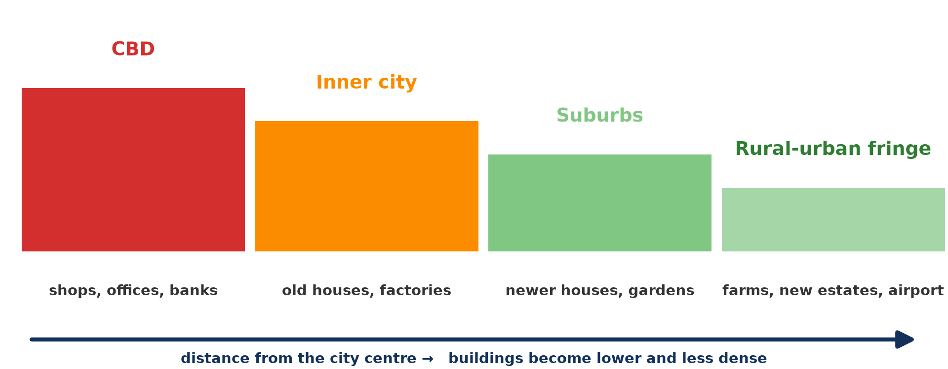
2. MAIN FUNCTIONAL ZONES
Activity 1
Zones from the centre outward.
Notes:
Activity 1. Look carefully at this diagram: zones from the centre outward. Observe every detail before I ask the question.

Slide 19
2. MAIN FUNCTIONAL ZONES
Activity 1: Question
Name the zones from the centre outward.
Notes:
Here is the question for Activity 1: Name the zones from the centre outward. Take one minute to think and write your answer in your rough notebook.

Slide 20
2. MAIN FUNCTIONAL ZONES
Activity 1: Answer
CBD, inner city, suburbs, rural-urban fringe.
Notes:
Let us check the answer together. CBD, inner city, suburbs, rural-urban fringe.

Slide 21

2. THE CBD
Activity 2
A central business district.
Notes:
Activity 2. Look carefully at this picture: a central business district. Observe every detail before I ask the question.

Slide 22
2. THE CBD
Activity 2: Question
Give two characteristics of the CBD.
Notes:
Here is the question for Activity 2: Give two characteristics of the CBD. Take one minute to think and write your answer in your rough notebook.

Slide 23
2. THE CBD
Activity 2: Answer
Tall buildings, offices, shops and banks; high land values.
Notes:
Let us check the answer together. Tall buildings, offices, shops and banks; high land values.

Slide 24
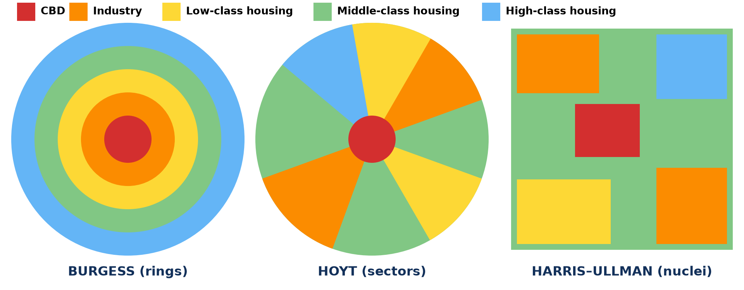
1. URBAN MORPHOLOGY: MODELS
Activity 3
Burgess, Hoyt and Harris–Ullman models.
Notes:
Activity 3. Look carefully at this diagram: burgess, Hoyt and Harris–Ullman models. Observe every detail before I ask the question.

Slide 25
1. URBAN MORPHOLOGY: MODELS
Activity 3: Question
How is Hoyt's model different from Burgess's?
Notes:
Here is the question for Activity 3: How is Hoyt's model different from Burgess's? Take one minute to think and write your answer in your rough notebook.

Slide 26
1. URBAN MORPHOLOGY: MODELS
Activity 3: Answer
Hoyt uses sectors along routes; Burgess uses rings.
Notes:
Let us check the answer together. Hoyt uses sectors along routes; Burgess uses rings.

Slide 27
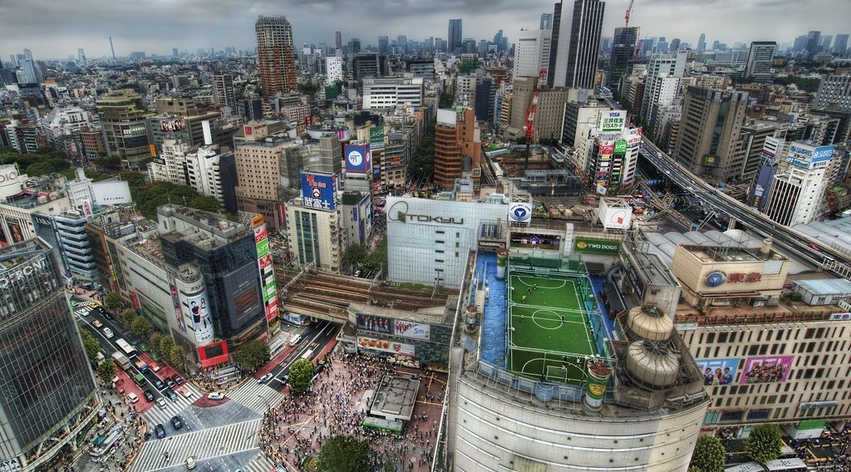
1. URBAN MORPHOLOGY: MODELS
Activity 4
A large city with many centres.
Notes:
Activity 4. Look carefully at this picture: a large city with many centres. Observe every detail before I ask the question.

Slide 28
1. URBAN MORPHOLOGY: MODELS
Activity 4: Question
Why does the Harris–Ullman model fit large modern cities?
Notes:
Here is the question for Activity 4: Why does the Harris–Ullman model fit large modern cities? Take one minute to think and write your answer in your rough notebook.

Slide 29
1. URBAN MORPHOLOGY: MODELS
Activity 4: Answer
They have several centres (nuclei), not just one CBD.
Notes:
Let us check the answer together. They have several centres (nuclei), not just one CBD.

Slide 30

2. SUBURBS
Activity 5
Suburbs.
Notes:
Activity 5. Look carefully at this picture: suburbs. Observe every detail before I ask the question.

Slide 31
2. SUBURBS
Activity 5: Question
Why are suburbs less dense than the inner city?
Notes:
Here is the question for Activity 5: Why are suburbs less dense than the inner city? Take one minute to think and write your answer in your rough notebook.

Slide 32
2. SUBURBS
Activity 5: Answer
Land is cheaper, so houses have gardens and space.
Notes:
Let us check the answer together. Land is cheaper, so houses have gardens and space.

Slide 33
BOARD SUMMARY
Board Summary
Topic: Internal City Structure
Sub-topic: Internal City Structure
Lesson 18: Structure of the City in MEDCs
Notes:
Now we are going to copy the board summary. Write the title and the headings neatly in your notebooks. I will give you enough time for each slide, so do not rush.

Slide 34
BOARD SUMMARY
DEFINITIONS
The key terms of this lesson are defined as follows:
Urban morphology: It is the form, layout and structure of a town.
CBD: It is the Central Business District, the commercial heart of a city.
Notes:
Let us copy the definitions. The key terms of this lesson are defined as follows. On this slide we have Urban morphology and CBD. Write each point on a new line, with the key term first, and explain it in your own words when we revise.

Slide 35
BOARD SUMMARY
1. Urban Morphology and Structure
The structure of cities in MEDCs is explained by models:
Burgess (1925): The city grows in concentric rings: CBD, zone in transition, low-class housing, middle-class housing and commuter zone. It is based on Chicago.
Notes:
Let us copy Urban Morphology and Structure. The structure of cities in MEDCs is explained by models. On this slide we have Burgess (1925). Write each point on a new line, with the key term first, and explain it in your own words when we revise. When you finish, we go to the next slide.

Slide 36
BOARD SUMMARY
1. Urban Morphology and Structure (continued)
Hoyt (1939): Land uses form sectors along transport routes from the centre. High-class housing and industry each form wedges.
Harris and Ullman (1945): Large cities have several nuclei (centres) such as the CBD, industrial districts and suburban centres. It fits modern large cities.
Notes:
We continue with Urban Morphology and Structure. On this slide we have Hoyt (1939) and Harris and Ullman (1945). Write each point on a new line, with the key term first, and explain it in your own words when we revise.

Slide 37
BOARD SUMMARY
1. Urban Morphology and Structure
Illustration: models of city structure
Notes:
Now draw this illustration in your notebook: models of city structure. Give it a title and label it clearly.

Slide 38
BOARD SUMMARY
2. Main Functional Zones
The spatial organisation of functions in a city is as follows:
CBD: It has shops, offices, banks and tall buildings at the most accessible point. Land values are highest and few people live there.
Notes:
Let us copy Main Functional Zones. The spatial organisation of functions in a city is as follows. On this slide we have CBD. Write each point on a new line, with the key term first, and explain it in your own words when we revise. When you finish, we go to the next slide.

Slide 39
BOARD SUMMARY
2. Main Functional Zones (continued)
Inner city and industrial zones: The inner city has old housing and industries near railways and canals. It may suffer from decay.
Notes:
We continue with Main Functional Zones. On this slide we have Inner city and industrial zones. Write each point on a new line, with the key term first, and explain it in your own words when we revise. When you finish, we go to the next slide.

Slide 40
BOARD SUMMARY
2. Main Functional Zones (continued)
Suburbs and the fringe: Suburbs have lower-density housing with gardens and shopping centres. The fringe mixes housing, farms and large facilities.
Notes:
We continue with Main Functional Zones. On this slide we have Suburbs and the fringe. Write each point on a new line, with the key term first, and explain it in your own words when we revise.

Slide 41
FORMATIVE EVALUATION
Evaluation 1
Describe the CBD.
Notes:
Now let us check what you have understood. Question 1: Describe the CBD. Answer in your exercise book.

Slide 42
FORMATIVE EVALUATION
Expected Answer
The commercial centre with shops, offices, banks, tall buildings and high land values.
Notes:
The expected answer is: the commercial centre with shops, offices, banks, tall buildings and high land values. If you got it right, well done.

Slide 43
FORMATIVE EVALUATION
Evaluation 2
Compare the Burgess and Hoyt models.
Notes:
Now let us check what you have understood. Question 2: Compare the Burgess and Hoyt models. Answer in your exercise book.

Slide 44
FORMATIVE EVALUATION
Expected Answer
Burgess: concentric rings. Hoyt: sectors along routes.
Notes:
The expected answer is: burgess: concentric rings. Hoyt: sectors along routes. If you got it right, well done.

Slide 45
REMEDIATION
Remediation
Fill in the blanks:
The commercial heart of a city is the ______.
Burgess's model uses ______ rings.
Hoyt's model uses ______.
Notes:
For those who need more practice, fill in the blanks in your exercise book. The answers are: number 1, CBD; number 2, concentric; number 3, sectors.

Slide 46
HOMEWORK
Homework
Draw a simple map of your town showing its zones and compare it with one model.
Notes:
For your homework: Draw a simple map of your town showing its zones and compare it with one model. We shall correct it at the beginning of our next lesson.

Slide 47
NEXT LESSON
Next Lesson
Our next lesson will be on:
Lesson 19: Bid Rent and Functional Segregation
Notes:
Our next lesson will be on Lesson 19: Bid Rent and Functional Segregation. Thank you for your attention, and see you next time.

Slide 48
BILINGUAL GAME
Bilingual Game (Jeu Bilingue)
English | Français
CBD | Le centre des affaires
Inner city | Le centre ancien, les quartiers péricentraux
Suburb | La banlieue
Ring | L'anneau
Sector | Le secteur
Model | Le modèle
Notes:
Let us play the bilingual game. I say a word in English, and you give me the French word. Then we do the reverse.

Slide 49
LOGBOOK
Official Logbook (1/2)
Module / Topic | Internal City Structure
Lesson Title | Lesson 18: Structure of the City in MEDCs
Expected Learning Outcomes | Describe the functional zones of a city. Explain the Burgess, Hoyt and Harris–Ullman models. Compare models with real cities.
Competence | Learners are able to describe the zones of a city and compare urban models.
Notes:
I record this information in the official logbook of the class after the lesson.

Slide 50
LOGBOOK
Official Logbook (2/2)
Matter Taught | DEFINITIONS; Urban Morphology and Structure; Main Functional Zones.
Evaluation | Formative evaluation and remediation exercise.
Homework | Draw a simple map of your town showing its zones and compare it with one model.
Enrolment / Present / Absent | ____ / ____ / ____
Achievement | To be completed after the lesson.
Notes:
I complete the second page of the logbook: the matter taught, the evaluation, the homework and the attendance.

Slide 51
TEACHER'S NOTE
Teacher's Note
Timing: Homework correction, plan, objectives 8 min | Recall, situation, action 10 min | 5 activities 30 min | Board summary (copying) 30 min | Evaluation, remediation 10 min | Homework, next lesson 5 min | Logbook 7 min
Without the projector (Activity 1): draw the zones.
Without the projector (Activity 2): describe a city centre.
Without the projector (Activity 3): draw the models.
Without the projector (Activity 4): discuss multiple centres.
Without the projector (Activity 5): compare zones.
Notes:
This slide is for me, the teacher: it gives the timing of the lesson and what to do if the projector is not available.

Slide 52
REFERENCES
References
National Geography Syllabus, MINESEC/IGE/IP-SS, 2019 — Module 5 (Settlement Geography).
Photo, Activity 2: “Central Business District” by alantankenghoe, CC BY 2.0, via Flickr (https://www.flickr.com/photos/57785759@N06/5548938771)
Photo, Activity 4: “Tokyo from the Air” by Trey Ratcliff, CC BY-NC-SA 2.0, via Flickr (https://www.flickr.com/photos/95572727@N00/4140101118)
Photo, Activity 5: “Chicago suburbs from the air” by Scorpions and Centaurs, CC BY-NC-SA 2.0, via Flickr (https://www.flickr.com/photos/62736719@N00/2912708983)
Diagrams and animations: drawn for this lesson (Geography Department).
Notes:
These are the references and picture credits used to prepare this lesson.

